Slide 1
Online Fee
Payment System

Slide 2
Introduction :
Online fee payment system provides sophisticated and secure payment solution for educational institutions to collect and manage fee transactions.
It also helps students to pay their college fees and exam fees without visiting college.
It helps for management to pay salary for staff through online.
Admin can generate various fee structures and fees receipt, also send instant alert to parents in case fee dues.
The main advantage for management is they can keep track about all bank transaction about staff salary and student fees.

Slide 3
Existing System :
User has to carry out each process manually for making college/exam fees payment.
In case of exam fee he/she has to take exam form fill manually .
Student has to submit all the documents xerox and paste a photo on exam form.
Staff has to verify all documents manually and it is lengthy process.
It is overhead for the staff to collect and maintain student details.

Slide 4
Disadvantages :
It is time consuming.
Retrieval of data takes lot of time.
It creates lot disturbances in college campus.
Student can miss the class by giving reason of fee payment.

Slide 5
Proposed System :
Online fee payment system, in this system there are two parts one is admin part and user part(students).
First part is admin can see all transaction related to student fees & staff salary.
Only admin will be able to add, delete or update students details related fees.
And admin can send mails to students. And he can see the list of students who had not made full payment of fees.
Admin can add directly salary to the staff account.

Slide 6
User part :
Second part that is students or user part they can make only fee payment and see their fee status. They are not allowed to make any changes.
Student can make college or exam fee payment.
Many payment methods are provided(debit/credit card/ATM card/UPI).
Students receive the receipt, they can take printout of receipt.
.

Slide 7
Features :
To provide huge maintenance of records.
Flexibility of transaction can be completed on time.
To provide easy and secure payment for exam and college fee.
To provide easy reference for staff and students.

Slide 8
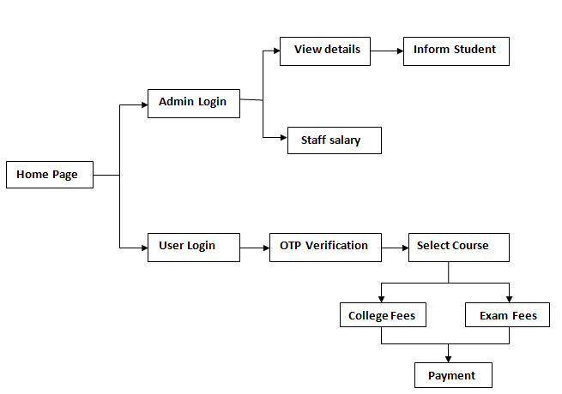
System Architecture:

Slide 9
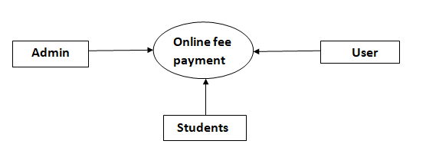
Data Flow Diagram:

Slide 10
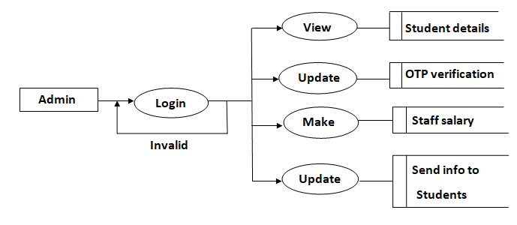
Admin:

Slide 11
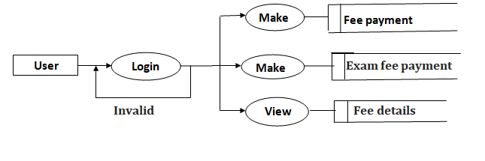
User(Students):

Slide 12
System Requirements:
Software Requirements:
Front End : HTML
Back End : MYSQL
Server :
Browser : Google chrome, Internet Explorer
Hardware Requirements:
Operating System : Windows
Processor : Intel core i3
RAM : 4GB
Hard Disk : 120GB and above
System Bus : 64bits

Slide 13
Conclusion :
The conclusion of the project is to provide user to make "Online Payment" of college/exam fees and also to pay salary for the staff .It provides secure and safe payment .
Admin can see all the transaction related to college fees, exam fees and staff salary in one view.
Advantage is we have not fixed amount to be paid user can pay the fees in instalment.
Admin can easily get student list who have not paid fees. Admin can send message/inform the students to make payment on time.

Slide 14
Thank you

